Slide 1

SIT112 Workshop week 1

Slide 2
contents
Installing Anaconda
1
Using JupyterLab for Data Science
2
Writing Python Code in Jupyter Notebooks
3
Introduction to Python - Part 1
4

Slide 3
directions
The workshop's objective is to introduce you to Python for Data Science & AI and get you started with the basics.
In SIT112, we work on plenty of exciting tasks.
These tasks are expressed in Python.
In this unit, we use a basic installation of Python provided by a tool called Anaconda Navigator. This tool includes a variety of Data Science tools, but for this unit, we will be utilizing JupyterLab.
JupyterLab is a software application that can be run in web browsers, such as Chrome, and it enables the user to write and execute Data Science and AI solutions in Python.
Let’s begin ...

Slide 4
Installing Anaconda
https://docs.anaconda.com/anaconda/install/windows/
https://docs.anaconda.com/anaconda/install/mac-os/
https://docs.anaconda.com/anaconda/install/linux/

Slide 5
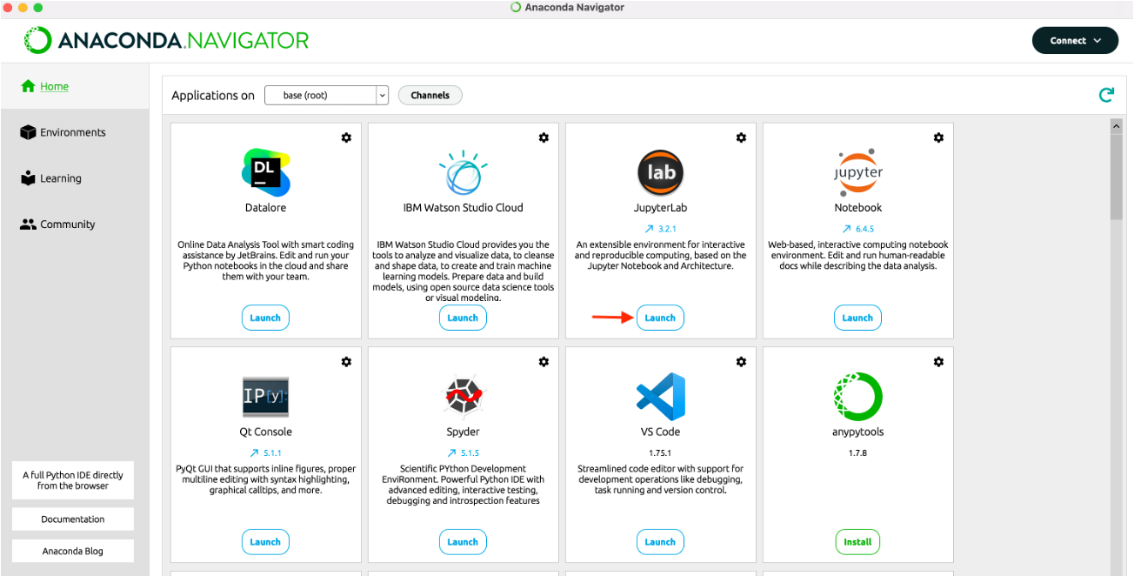
Launching jupyterlab from Anaconda navigator

Slide 6
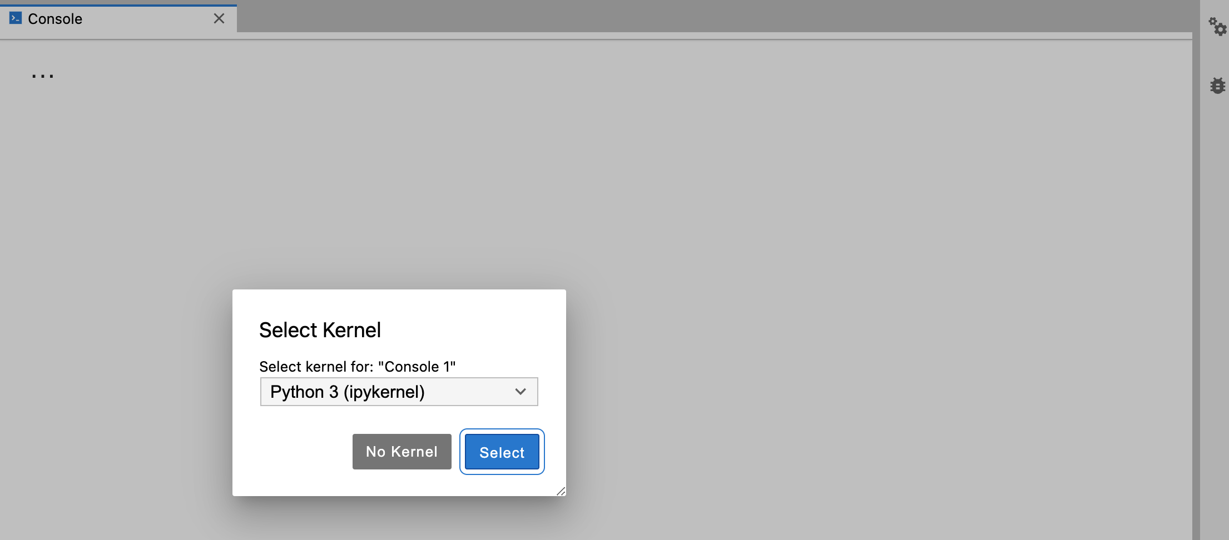
Selecting the kernel
If at any point, JupyterLab prompted you to select a kernel, choose Python 3.

Slide 7
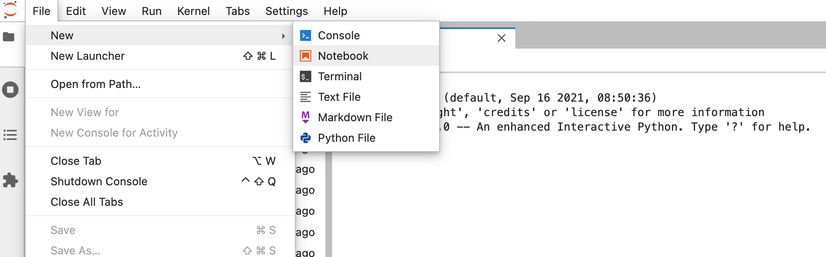
Create a jupyter notebook
To write Python programs in this unit, create a Jupyter Notebook in JupyterLab. Notebooks are the preferred tool for coding in SIT112.

Slide 8
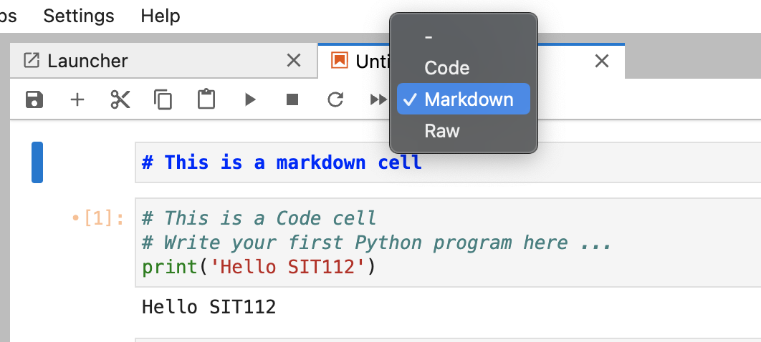
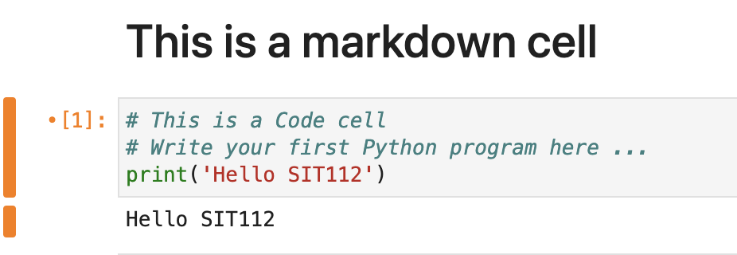
Notebook cells
Each Jupyter notebook is composed of Cells. We are mainly interested in Markdown and Code cells.

Slide 9
Notebook cells: Markdown
To create a markdown cell, simply select "Markdown" from the dropdown menu in the toolbar or press the keyboard shortcut "Esc" followed by the letter "M".
Once the cell is created, you can enter and format text using Markdown syntax, and then render the formatted output by running the cell (by pressing "Shift" + "Enter" or clicking the "Run" button in the toolbar).

Slide 10
Notebook cells: Markdown
A markdown cell allows the user to enter and format text using Markdown syntax. Markdown is a lightweight markup language that allows for easy formatting of text with simple syntax.
Markdown cells are used to provide documentation, instructions, or explanatory text to accompany code and visualizations in a Jupyter notebook. They can contain formatted text, headers, lists, tables, links, images, and more.
Markdown cells can also be used to write reports or presentations in a notebook format.

Slide 11
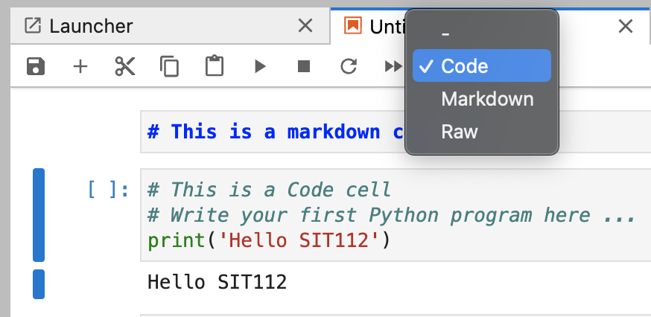
Notebook cells: code
To create a code cell, simply select "Code" from the dropdown menu in the toolbar or press the keyboard shortcut "Esc" followed by the letter "Y".
Once the cell is created, you can write code in the selected programming language and execute it by running the cell (by pressing "Shift" + "Enter" or clicking the "Run" button in the toolbar). The output of the code will be displayed directly below the cell.

Slide 12
Notebook cells: code
A code cell allows the user to write and execute Python code.
Code cells are used to perform computations, manipulate data, and create visualizations within a notebook.
Code cells also have access to various libraries, modules, and packages, making it possible to import and use external functionality within the notebook.
Additionally, code cells can be used to define functions, classes, and other reusable components that can be called from other cells within the notebook.

Slide 13
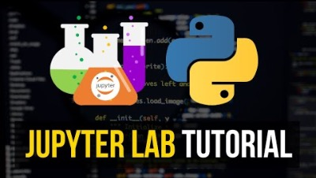

Slide 14
Common JupyterLab Keyboard Shortcuts
Shift + Enter: run selected cell or cells - if no cells below, insert a code cell below
Ctrl + S: save and checkpoint
Ctrl + Shift + S: save as
Ctrl + F: find
Ctrl + B: toggle hide/show left sidebar
https://gist.github.com/discdiver/9e00618756d120a8c9fa344ac1c375ac

Slide 15
Programming skills for sit112 Tasks
In this unit, we utilize Python to implement Data Science solutions. It is important to note that this course does not teach you how to program in Python. We only provide a brief introduction to the language syntax.
However, the ability to write programs in Python depends on your programming and problem-solving skills. The level of proficiency needed to complete this unit depends on your target grade.

Slide 16
Programming skills for sit112 Tasks
Target Grade | Required Competence in Programming
Pass | To be able to comprehend and execute code. To be able to write code for basic problems with guidance (you will be given the solution and asked to try do it yourself. Then you will reflect on your understanding by submitting s report).
Credit | To be able to comprehend and execute code. To be able to write code for basic problems with limited guidance (you will be given part of the solution).
Distinction | To be able to comprehend and execute code. To be able to write code independently for moderately complex problems (real-world scenarios).
High Distinction | To be able to comprehend and execute code. To be able to write code independently for complex problems (real-world scenarios).

Slide 17
Help Hub
If you need assistance with your Python skills, you can join the help-hub hours.
Multiple sessions are available throughout the week, including weekends. For further information on the hours, Zoom links, and other details, please refer to Cloud Deakin.

Slide 18
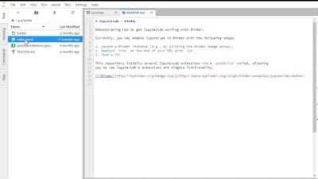
Introduction to Python – Part1
Please open the attached Notebook in JupyterLab and follow the instructions.
Launch JupyterLab in your web browser.
Navigate to the directory where the Notebook is saved.
Click on the Notebook file to open it in JupyterLab.
Follow the instructions provided in the Notebook.

Slide 19
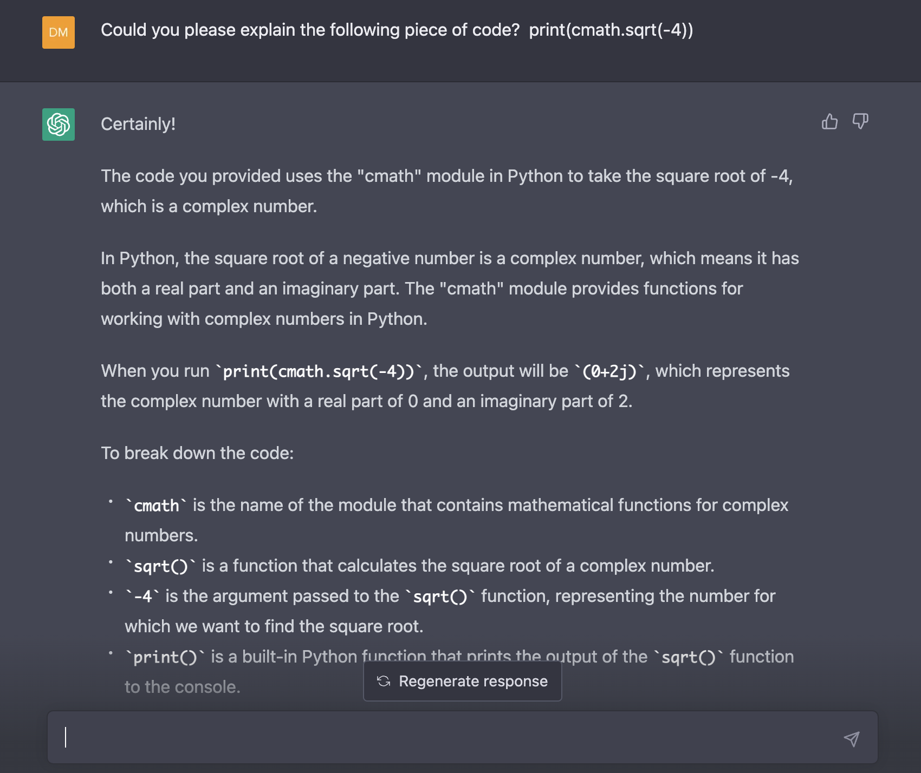
Use chatgpt when appropriate
You are encouraged to – creatively - use ChatGPT in this unit.
You can ask ChatGPT to explain what a piece of code does. Check the answers with your tutor to make sure you are not misled by AI ;)
https://chat.openai.com

Slide 20
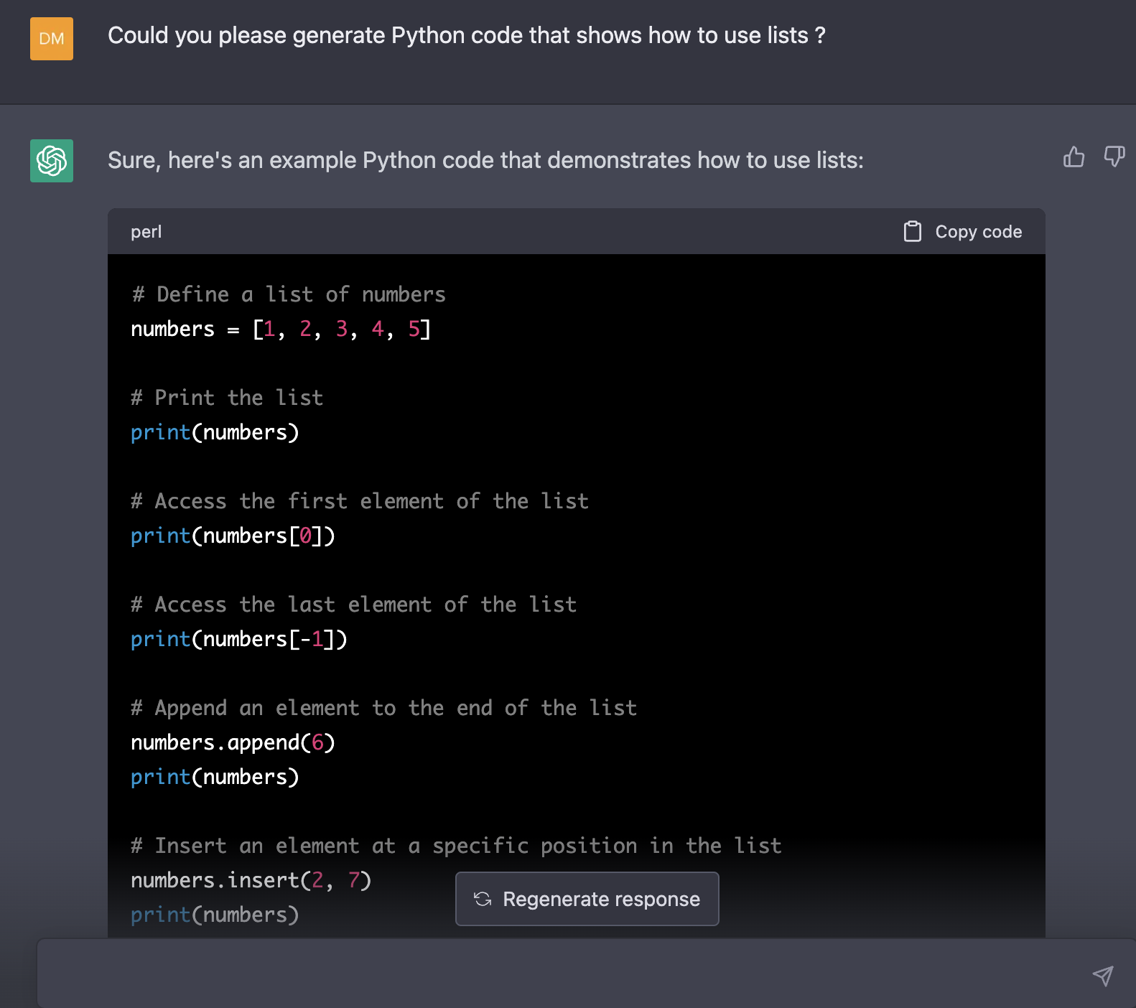
Use chatgpt when appropriate
You can even ask ChatGPT to generate sample code for you.

Slide 21
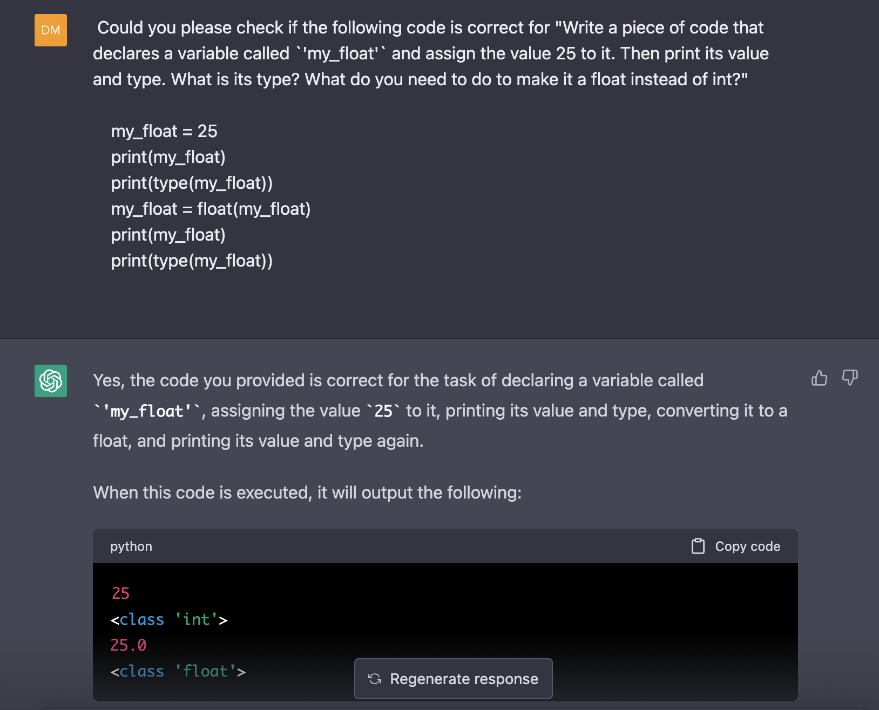
Use chatgpt when appropriate
Or check if your code is correct!

Slide 22
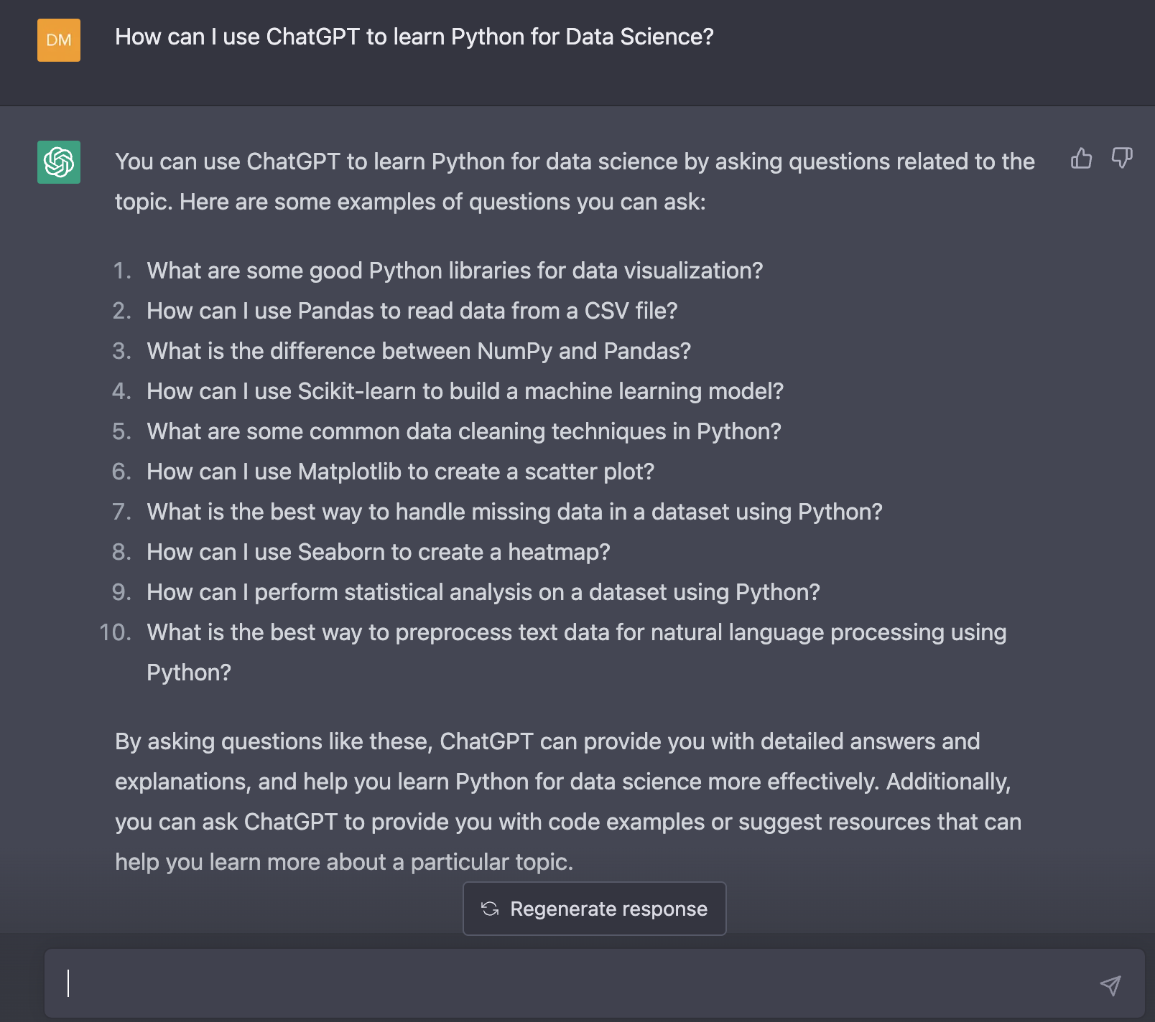
Use chatgpt when appropriate
What else? Ask ChatGPT!

Slide 23
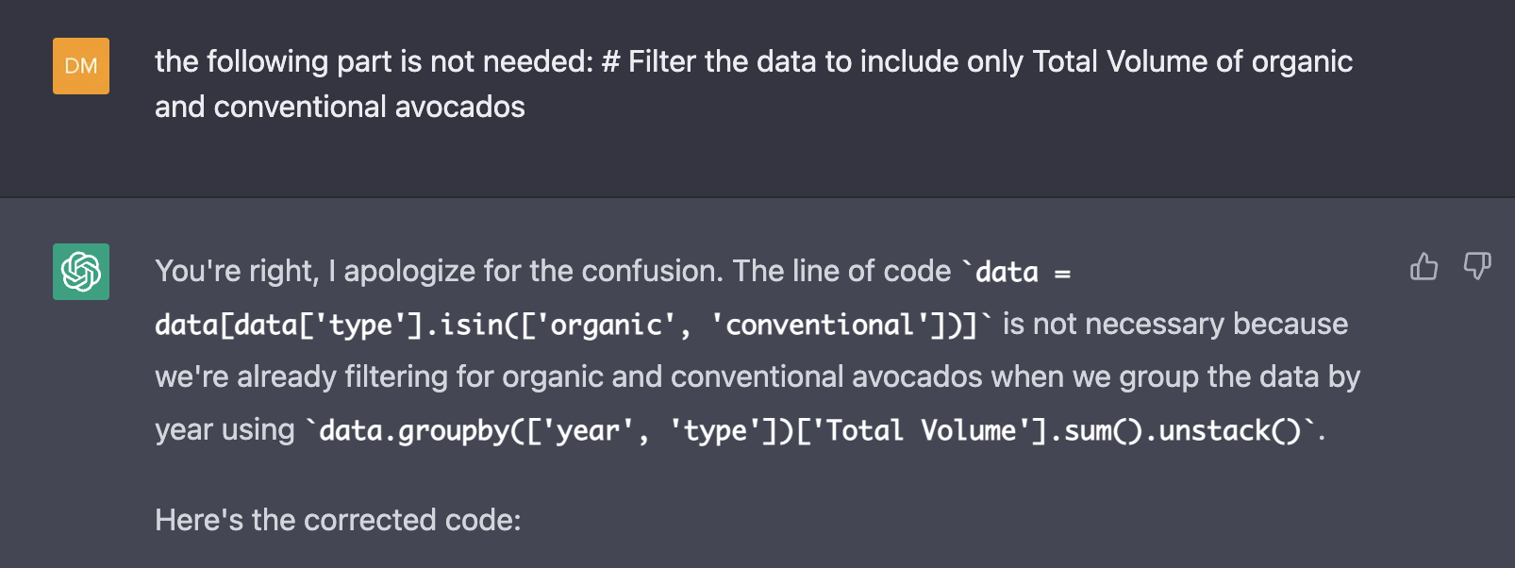
Use chatgpt when appropriate
Always check if the suggestion makes sense!

Slide 24

Learn more
https://www.programiz.com/python-programming/examples

